Slide 1
Chapter 4: Threads
Notes:
‹#›

Slide 2
Chapter 4: Threads
Overview
Multicore Programming
Multithreading Models
Thread Libraries
Implicit Threading
Threading Issues
Operating System Examples
Notes:
‹#›

Slide 3
Objectives
To introduce the notion of a thread—a fundamental unit of CPU utilization that forms the basis of multithreaded computer systems
To discuss the APIs for the Pthreads, Windows, and Java thread libraries
To explore several strategies that provide implicit threading
To examine issues related to multithreaded programming
To cover operating system support for threads in Windows and Linux

Slide 4
Motivation
Most modern applications are multithreaded
Threads run within application
Multiple tasks with the application can be implemented by separate threads
Update display
Fetch data
Spell checking
Answer a network request
Process creation is heavy-weight while thread creation is light-weight
Can simplify code, increase efficiency
Kernels are generally multithreaded

Slide 5
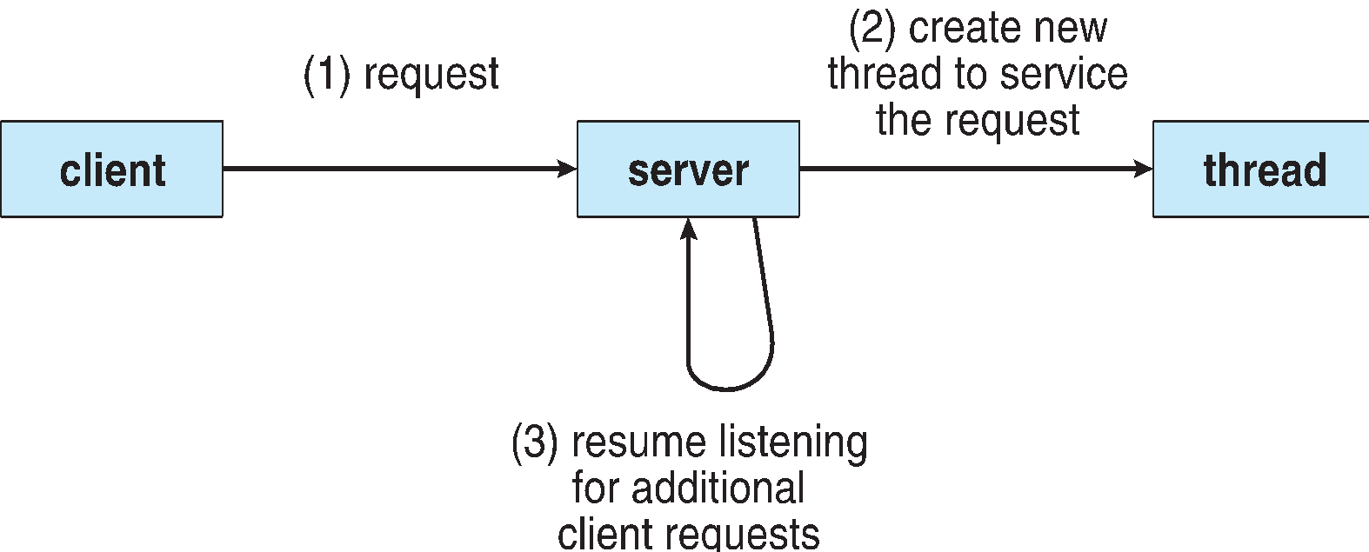
Multithreaded Server Architecture

Slide 6
Benefits
Responsiveness – may allow continued execution if part of process is blocked, especially important for user interfaces
Resource Sharing – threads share resources of process, easier than shared memory or message passing
Economy – cheaper than process creation, thread switching lower overhead than context switching
Scalability – process can take advantage of multiprocessor architectures
Notes:
‹#›

Slide 7
Multicore Programming
Multicore or multiprocessor systems putting pressure on programmers, challenges include:
Dividing activities
Balance
Data splitting
Data dependency
Testing and debugging
Parallelism implies a system can perform more than one task simultaneously
Concurrency supports more than one task making progress
Single processor / core, scheduler providing concurrency

Slide 8
Multicore Programming (Cont.)
Types of parallelism
Data parallelism – distributes subsets of the same data across multiple cores, same operation on each
Task parallelism – distributing threads across cores, each thread performing unique operation
As # of threads grows, so does architectural support for threading
CPUs have cores as well as hardware threads
Consider Oracle SPARC T4 with 8 cores, and 8 hardware threads per core

Slide 9
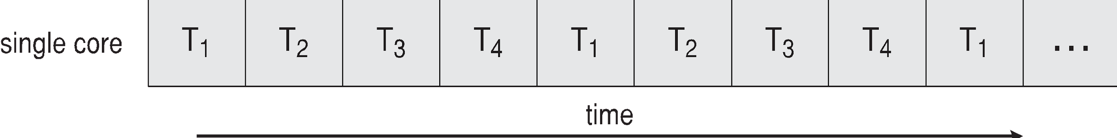
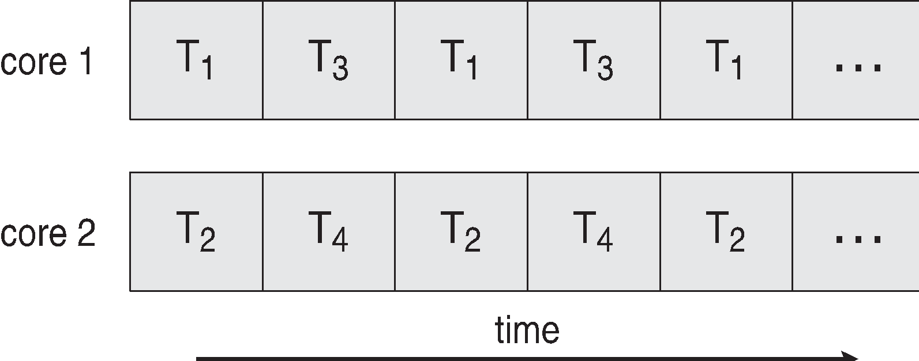
Concurrency vs. Parallelism
Concurrent execution on single-core system:
Parallelism on a multi-core system:

Slide 10
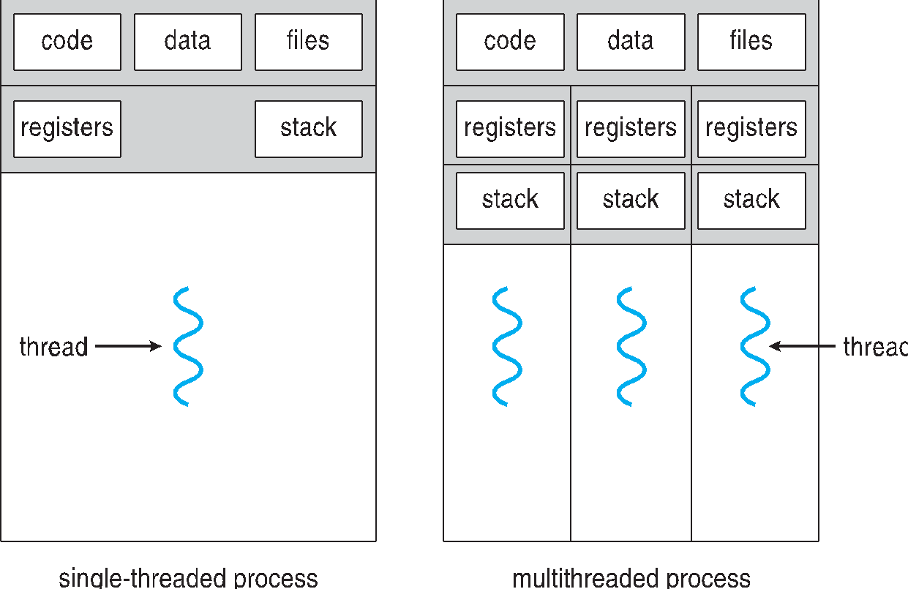
Single and Multithreaded Processes
Notes:
‹#›

Slide 11
User Threads and Kernel Threads
User threads - management done by user-level threads library
Three primary thread libraries:
POSIX Pthreads
Windows threads
Java threads
Kernel threads - Supported by the Kernel
Examples – virtually all general purpose operating systems, including:
Windows
Solaris
Linux
Tru64 UNIX
Mac OS X
Notes:
‹#›

Slide 12
Thread Libraries
Thread library provides programmer with API for creating and managing threads
Two primary ways of implementing
Library entirely in user space
Kernel-level library supported by the OS

Slide 13
Pthreads
May be provided either as user-level or kernel-level
A POSIX standard (IEEE 1003.1c) API for thread creation and synchronization
Specification, not implementation
API specifies behavior of the thread library, implementation is up to development of the library
Common in UNIX operating systems (Solaris, Linux, Mac OS X)
Notes:
‹#›

Slide 14
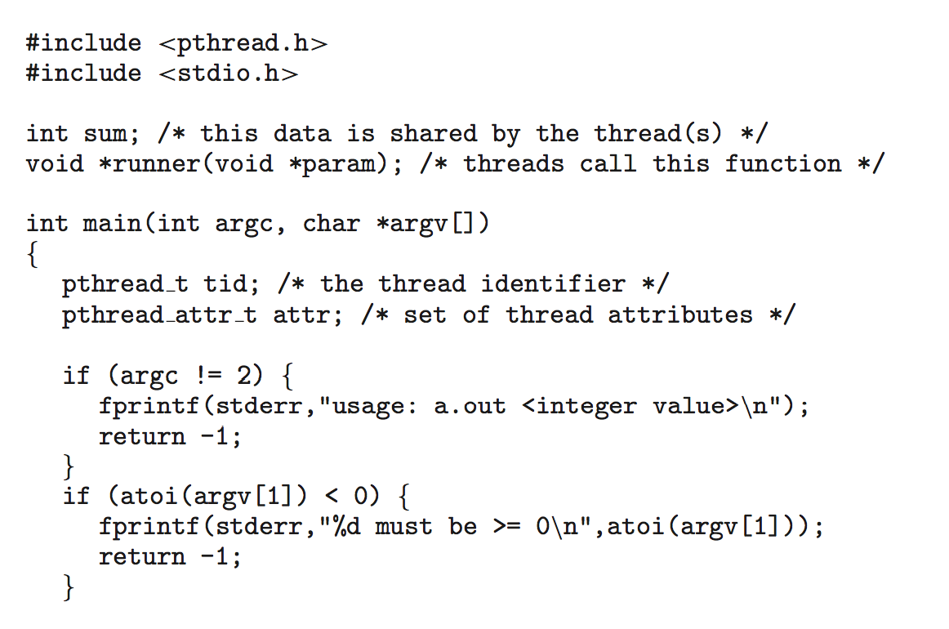
Pthreads Example

Slide 15
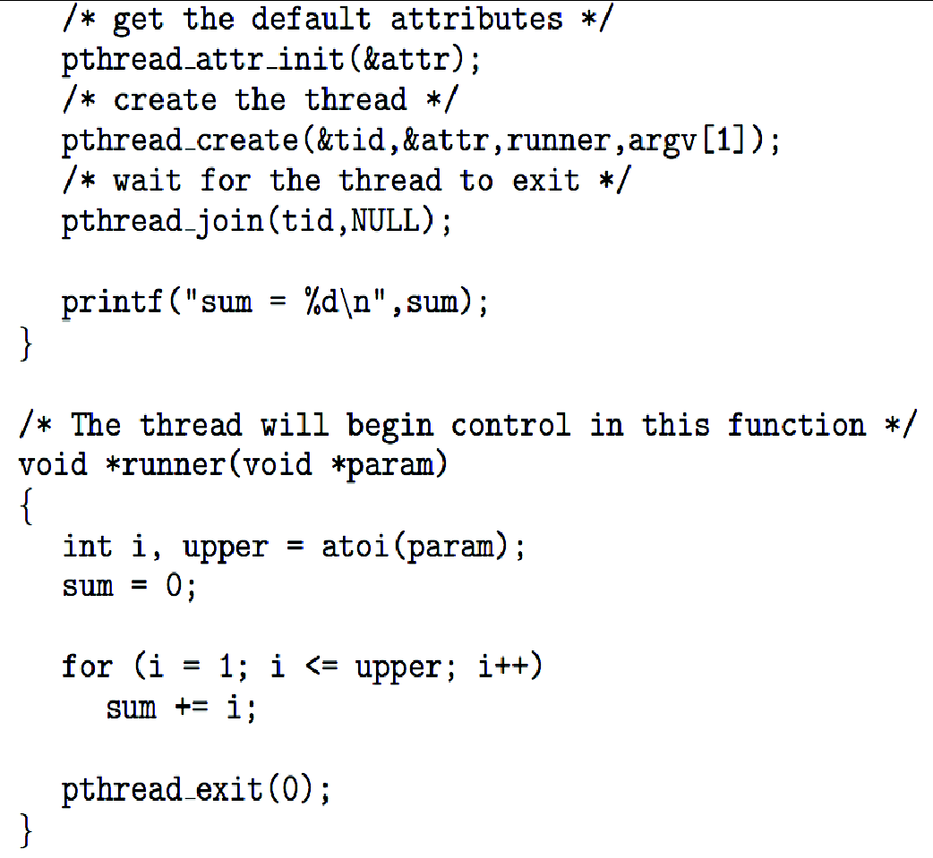
Pthreads Example (Cont.)

Slide 16
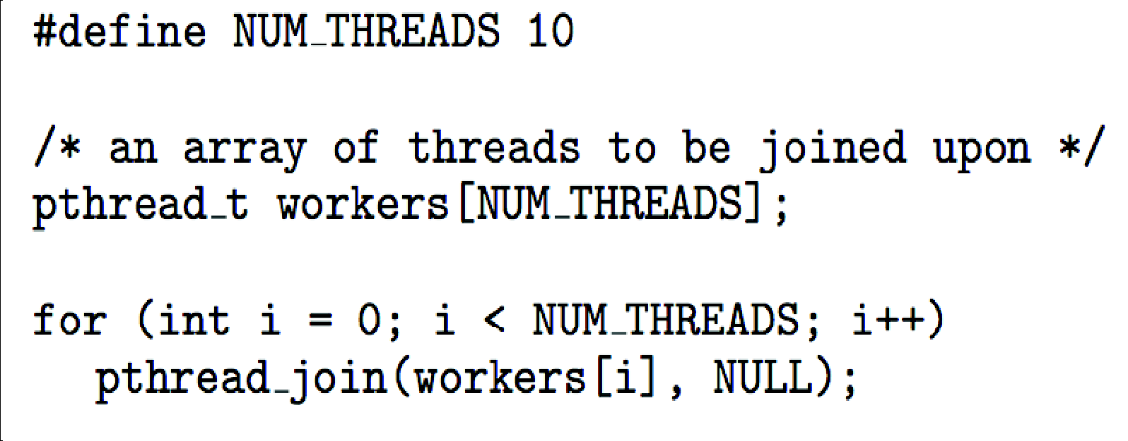
Pthreads Code for Joining 10 Threads

Slide 17
Semantics of fork() and exec()
Does fork()duplicate only the calling thread or all threads?
Some UNIXes have two versions of fork
exec() usually works as normal – replace the running process including all threads
Notes:
‹#›

Slide 18
Signal Handling
Signals are used in UNIX systems to notify a process that a particular event has occurred.
A signal handler is used to process signals
Signal is generated by particular event
Signal is delivered to a process
Signal is handled by one of two signal handlers:
default
user-defined
Every signal has default handler that kernel runs when handling signal
User-defined signal handler can override default
For single-threaded, signal delivered to process
Notes:
‹#›

Slide 19
Signal Handling (Cont.)
Where should a signal be delivered for multi-threaded?
Deliver the signal to the thread to which the signal applies
Deliver the signal to every thread in the process
Deliver the signal to certain threads in the process
Assign a specific thread to receive all signals for the process
Notes:
‹#›

Slide 20
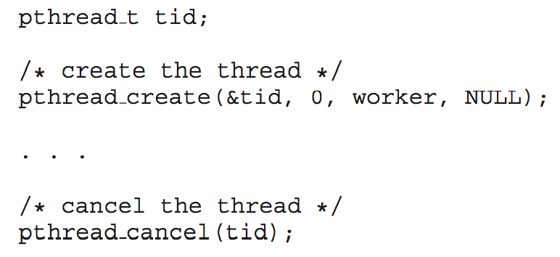
Thread Cancellation
Terminating a thread before it has finished
Thread to be canceled is target thread
Two general approaches:
Asynchronous cancellation terminates the target thread immediately
Deferred cancellation allows the target thread to periodically check if it should be cancelled
Pthread code to create and cancel a thread:
Notes:
‹#›

Slide 21
End of Chapter 4
Notes:
‹#›

